Slide 1
Programming Language
A programming language is a computer language that is used by programmers (developers) to communicate with computers. It is a set of instructions written in any specific language ( C, C++, Java, Python) to perform a specific task.
A programming language is mainly used to develop desktop applications, websites, and mobile applications.

Slide 2
Types Of Programming Language
Low-level programming language
Low-level language is machine-dependent (0s and 1s) programming language.
The processor runs low- level programs directly without the need of a compiler or interpreter, so the programs written in low-level language can be run very fast.
Low-level language is further divided into two parts -

Slide 3
I. Machine Language
Machine language is a type of low-level programming language. It is also called as machine code or object code.
Machine language is easier to read because it is normally displayed in binary or hexadecimal form (base 16) form.
It does not require a translator to convert the programs because computers directly understand the machine language programs.
The advantage of machine language is that it helps the programmer to execute the programs faster than the high-level programming language.

Slide 4
Ii. Assembly Language
Assembly language (ASM) is also a type of low-level programming language that is designed for specific processors.
It represents the set of instructions in a symbolic and human-understandable form. It uses an assembler to convert the assembly language to machine language.
The advantage of assembly language is that it requires less memory and less execution time to execute a program.

Slide 5
2. High-level Programming Language
It is designed for developing user-friendly software programs and websites. This programming language requires a compiler or interpreter to translate the program into machine language (execute the program).
The main advantage of a high-level language is that it is easy to read, write, and maintain.
High-level programming language includes Python, Java, JavaScript, PHP, C#, C++, Objective C, LISP, FORTRAN, and Swift programming language.
i. Procedural Oriented programming language
POP language is derived from structured programming and based upon the procedure call concept. It divides a program into small procedures called routines or functions. it helps programmers to easily track the program flow and code can be reused in different parts of the program.
Example: C, FORTRAN, Basic, Pascal, etc.

Slide 6
ii. Object-Oriented Programming language
Object-Oriented Programming (OOP) language is based upon the objects. In this programming language, programs are divided into small parts called objects. It is used to implement real-world entities like inheritance, polymorphism, abstraction, etc in the program to makes the program resusable, efficient, and easy-to-use.
OOP is faster and easier to execute, maintain, modify, as well as debug.
iii. Natural language
Natural language is a part of human languages such as English, Russian, German, and Japanese. It is used by machines to understand, manipulate, and interpret human's language. It is used by developers to perform tasks such as translation, automatic summarization, Named Entity Recognition (NER), relationship extraction, and topic segmentation.
It helps users to ask questions in any subject and directly respond within seconds.

Slide 7
Software Development Tools
Software development tools are computer programs used by software development teams to create, debug, manage and support applications, frameworks, systems, and other programs.
These tools are also commonly referred to as software programming tools.
Software development tools include:
Linkers
Code editors
GUI designers
Performance analysis tools
Assemblers
Compilers

Slide 8
Selecting Language And Tool
We should know all the components for a better view and this will help you to choose a specific programming language.
A good view at the beginning of your project helps in choosing a sensible programming language and this leads to less time spent on maintaining the project, scaling up the project, and securing the project later on.
We can write good software in Java, C#, Python, PHP, or any other languages then we can also write bad software using these languages.
No single language is the best choice for any software.

Slide 9
Targeted platform: The most important thing to decide is how and where the program would function. It is well known that not all the languages can run in all types of platforms(Linux, Windows).
Language domain tie: It is important to select the language according to the problem domain which is present. A better and simple method to perform is by finding the language in the same industry or domain or also by looking for a code which resolves problems you may have.
Efficiency: It is important for the compilers to match with the language you are selecting. It should be efficient so that it helps in making the language to function fast.
Performance and elasticity: When you are choosing a language, you have to remain flexible enough. By being flexible, you can add extra features and programs in it. Moreover, its overall performance should be according to your liking and suitability.
Tool support: It is recommended to purchase tool oriented language which provides several elements and also methods to control, work and edit.
Time to production and expressiveness: Ensure to choose the language which is best expressive. The time you take to produce codes and programs should not remain bothersome to you.

Slide 10
Questions to Ask When Choosing a Programming Language
Does language have proper ecosystem support? Is it going to work for the long haul? Is vendor support available for the language?
What is the environment for the project (web, mobile, etc)?
Do we need to consider some infrastructure such as new hardware? What kind of deployment do we need?
What’s the preference of the client?
Any specific requirements for libraries, features, and tools for the programming language?
Is the developer available to code in this language or do we need to hire new developers? Are they experienced and comfortable in working with this language, or do they need to learn the language quickly?
What are some important constraints of this project? Time, budget, resources?
What’s the performance consideration and is the languages suitable to accommodate this performance?
What’s the security consideration and do we need to use any third-party tool?

Slide 11
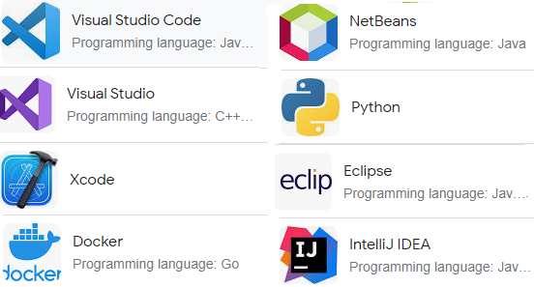
Development Tools

Slide 12
Good Programming Practices
Good programming practices are a set of informal rules that many software developers in computer programming follow to improve software quality.
Coding standards are a set of guidelines and best practices that are used to create consistent, high-quality code.
Consider coding standards as rules, techniques, and best practices to develop cleaner, more readable, and more efficient code with minimal errors.
They offer a uniform format for software engineers to build sophisticated and highly functional code.
It’s important to use coding best practices to help ensure better quality code for yourself and for anyone who may have to extend that code in the future.

Slide 13
Contd..
There are a few best practices when it comes to learning how to code, and they center around these 7 concepts:
Meaningful naming (Variable and Class and function naming conventions)
Clear and concise comments
Code Indentations
Portability
Low coupling and high cohesion
Reusability and scalability
Testing

Slide 14
Meaningful naming
Our code’s variable names and function names should be intuitive.
Ideally, we should be able to guess what a function does based on the function’s name.
We should give intuitive names to objects, variables, classes, functions, and constants.
However, we also strive to keep our code concise and readable. If the most intuitive name is too long to keep code concise, we may use its shorthand. Just be mindful that the shorthand should remain intuitive as well.
It's an essential aspect of learning how to code.
Similar to variable naming conventions, functions and classes should also consist of descriptive titles that are delimited by using conventions, as mentioned above.
The purpose of using appropriate naming conventions is to make sure that the variables, functions, and classes within our code can be easily distinguished from one another.

Slide 15
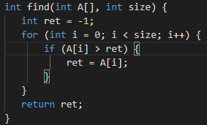
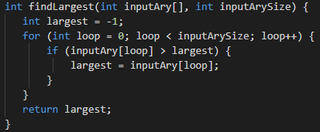
The following code does not follow meaningful naming conventions. This makes it difficult to understand and reuse. | In contrast, the following code example has the same functionality, but meaningful naming makes it easier to understand.

Slide 16
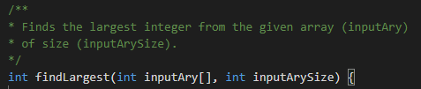
Add Clear and Concise Comments to our Code
It’s pretty much guaranteed that our code will be modified or updated over time.
It’s also true that almost all developers will come across someone else’s code at one time or another.
A bad habit among inexperienced programmers is to include little or no comments while coding.
source code can’t always be self-explanatory. When code can’t explain itself, comments should step in

Slide 17

Code Indentation
Formatting and indentation are necessary to organize your code.
Ideal coding formatting and indentation include correct spacing, line length, wraps and breaks.
By employing indentations, white-spacing, and tabs within the code, programmers ensure their code is readable and organized.

Slide 18
Portability
Portability is a key aspect that ensures functionality of your program.
If our code contains literal (hard-coded) values of environmental parameters, such as usernames, host names, IP addresses or URLs, it will not run on a host having a different configuration than yours.
Reusability and Scalability
In coding, reusability is an essential design goal.
Because if modules and components have been tested already, a lot of time can be saved by reusing them.
Software projects often begin with an existing framework or structure that contains a previous version of the project.
Therefore, by reusing existing software components and modules, we can cut down on development cost and resources.

Slide 19
Testing
Testing your work while coding is a vital part of software development and should be well-planned.
It requires the test cases to be prepared before the actual coding of the software begins.
Also, while basic unit testing is a good practice to adopt, it is also useful to perform Automated Functional Testing (AFT) with the help of tools such as Selenium.

Slide 20
Unit 5(Coding): Assignment
Explain about Programming language and development tools.
How can you select best language and tool?
Why do we need Good programming practices? Write the reasons.

